Slide 1
Corporación Favorita Grocery Sales Forecasting
Kalyan Bhattacharjee

Slide 2














A little about me
Scientist with business and engineering acumen focusing on integrating machine learning and real time analytics into data driven modern systems
Expertise:
3 years of experience in data driven operations research and AI (PhD)
1 year of commercial experience in production level machine learning, AI and data driven analytics
Learning:

Slide 3
Overview
Challenge
Dataset
Details
EDA
Solutions
Suggestions

Slide 4
Challenge
Grocery stores are always at high risks of either running out or overstocked in the absence of a proper forecasting model.
Forecasting model needs to be accurate and generalized enough to accommodate business needs as well as customer satisfaction.
Corporación Favorita is one of the largest Ecuadorian based supermarket chain and the problem scope is within their sales division.
The idea is to propose an accurate forecasting model to predict the sales in future timeframes.

Slide 5
Dataset
The training dataset contains (January 2013- 15th August 2017):
Sales by date, store, item and flag related to whether item on promotion or not.
The test dataset only covers 16th August, 2017 to 31st August, 2017.
Some additional data are provided:
Stores information such as location and type
Items metadata such as class and whether they are perishable or not.
Count of sales transactions for the training data.
Daily oil price because of strong economic dependency of Ecuador on oil.
List of holidays

Slide 6

Details (1 of 2)
Training data contains 12549704 records.
54 stores and promotion feature contains NAs.
Unit sales is the target feature: negative values indicate item return.
Some test items are not included in the training data
The importance of public sector pay days (on the 15th and the end of the month) as well as the impact of a major earthquake on April 16 2016.

Slide 7
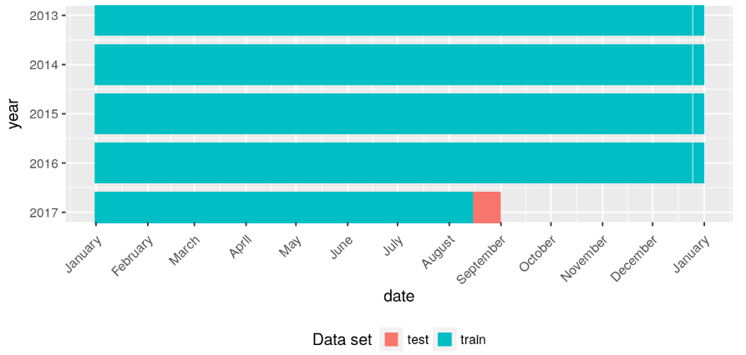
Details (2 of 2)

Slide 8
Difficulties
Huge data size.
Lots of categorical features such as item, store, promotion flag, city, state, type of item, family of item, class of item, cluster of store, holiday’s type, name, locale description, transferred flag etc.
Very few features to start with for forecasting.
Noisy observation in relation to temporal aspect.

Slide 9
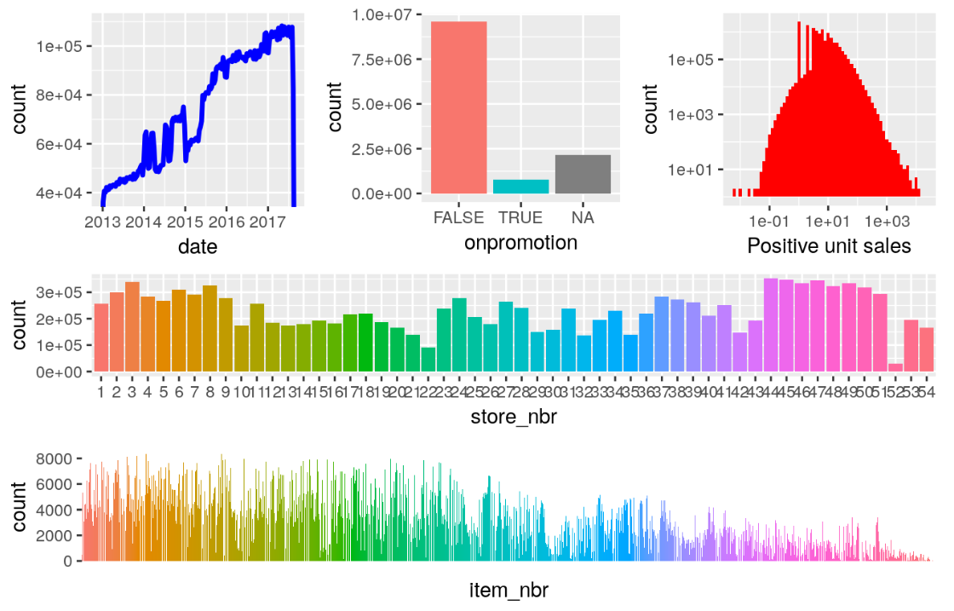
EDA
Training Data
(double-logarithmic axes on the unit sales plot)

Slide 10
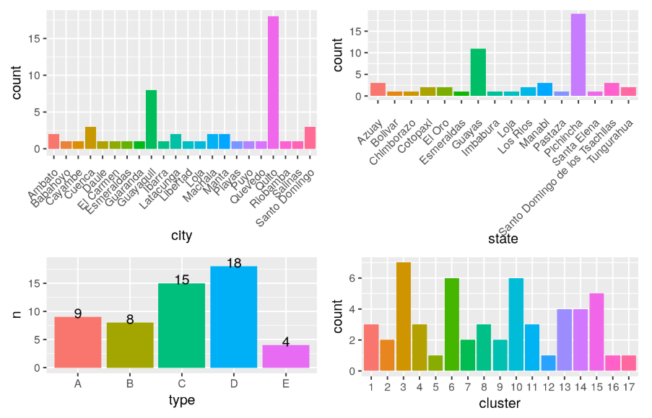
EDA
Stores

Slide 11
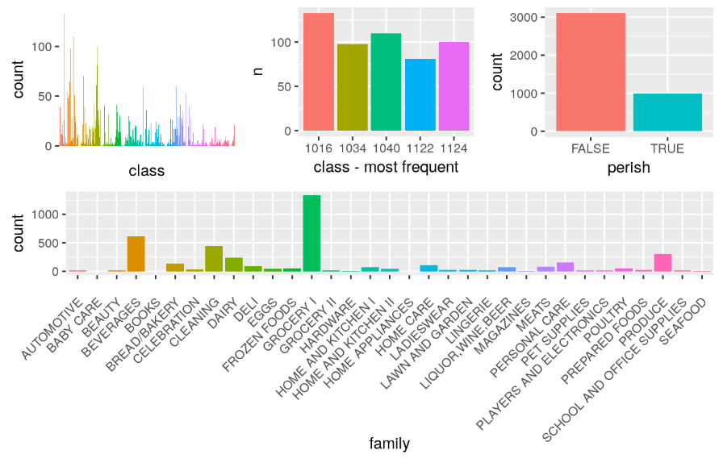
EDA
Items

Slide 12
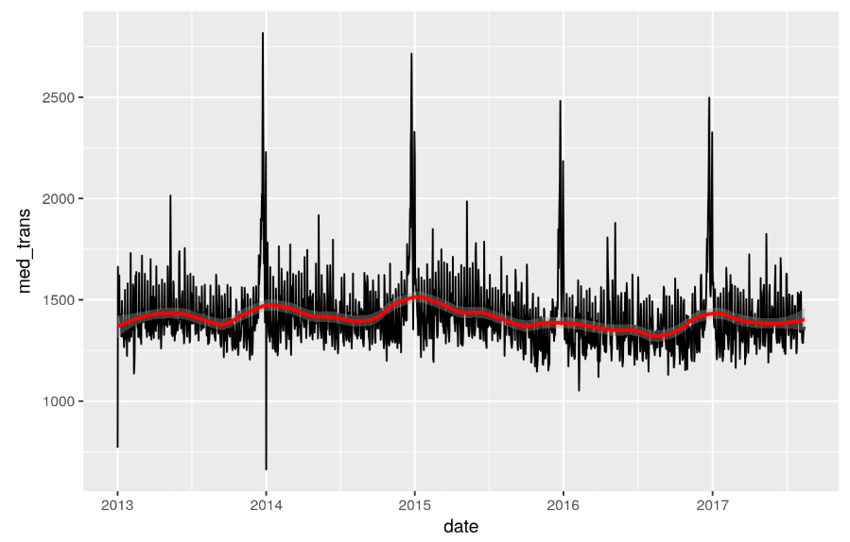
EDA
Transaction

Slide 13
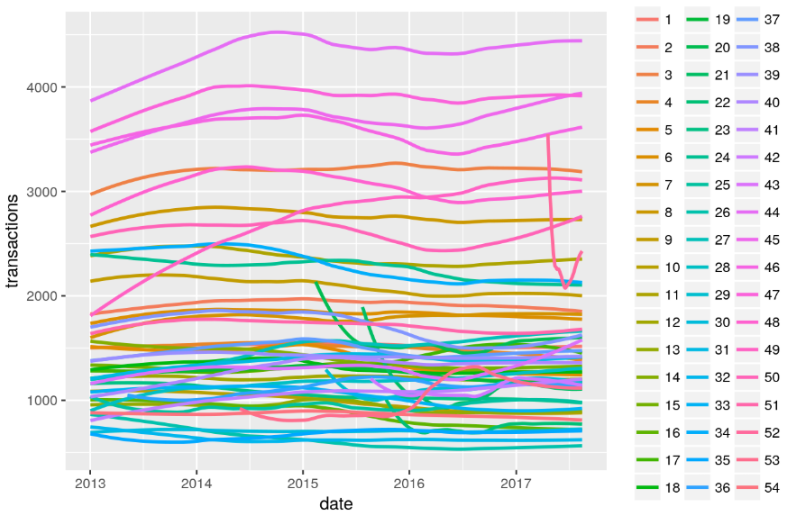
EDA
Store transactions

Slide 14
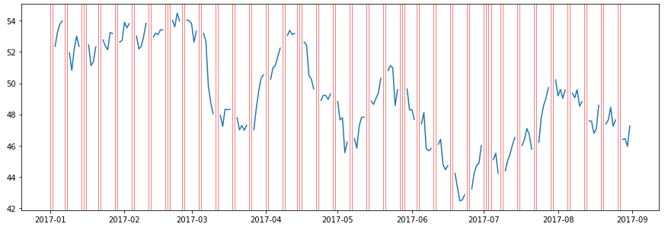
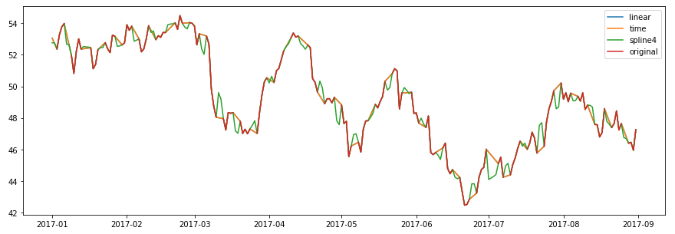
EDA
Oil price

Slide 15
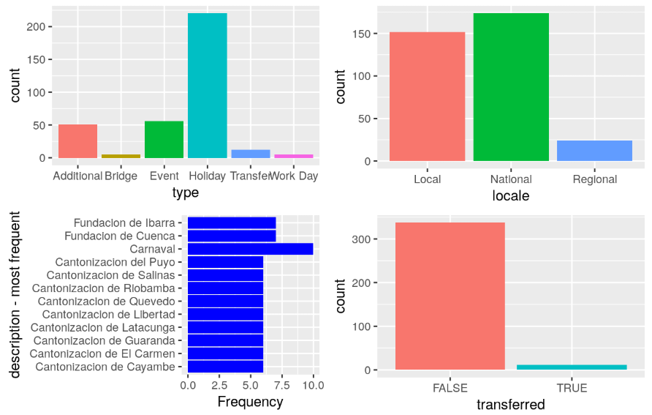
EDA
Holidays

Slide 16
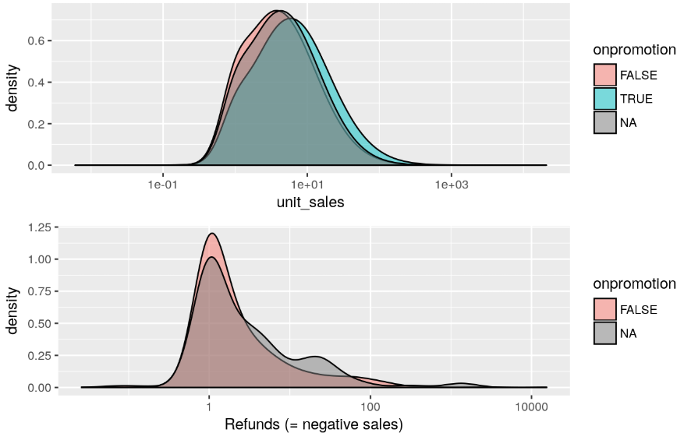
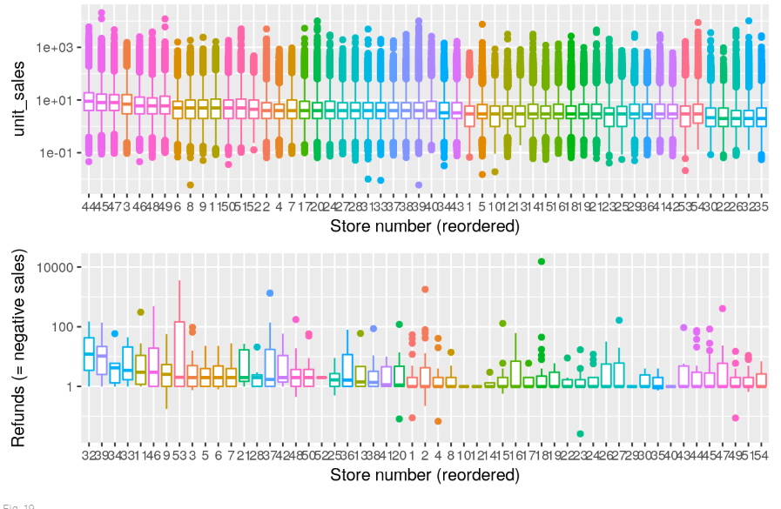
Sales and refunds

Slide 17
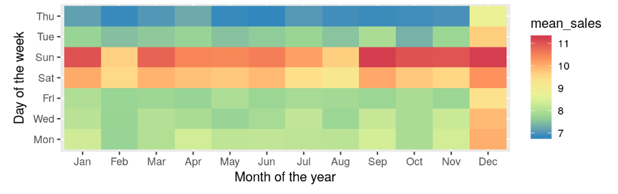
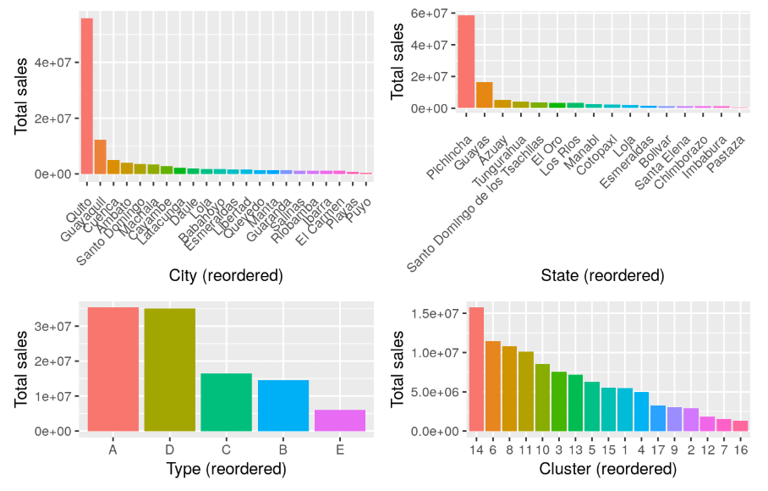
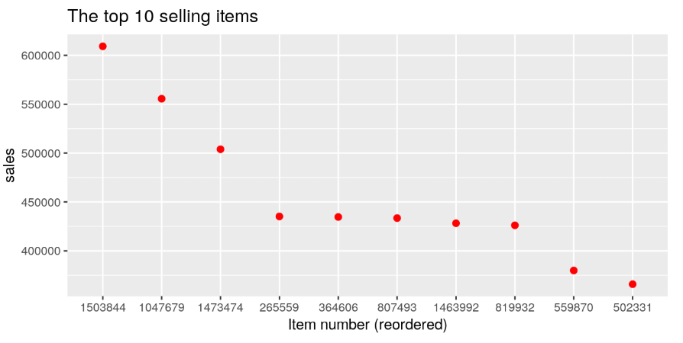
Sales

Slide 18
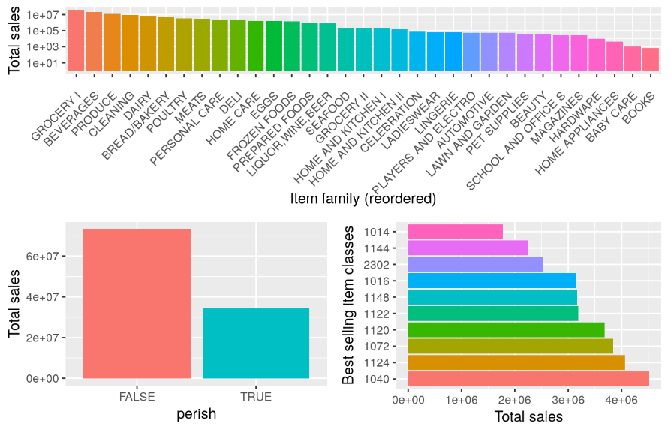
Items

Slide 19
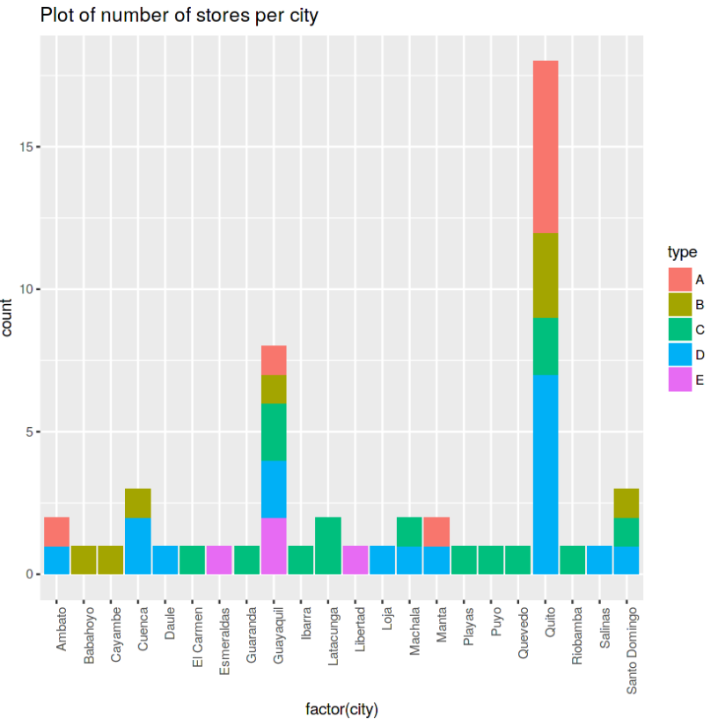
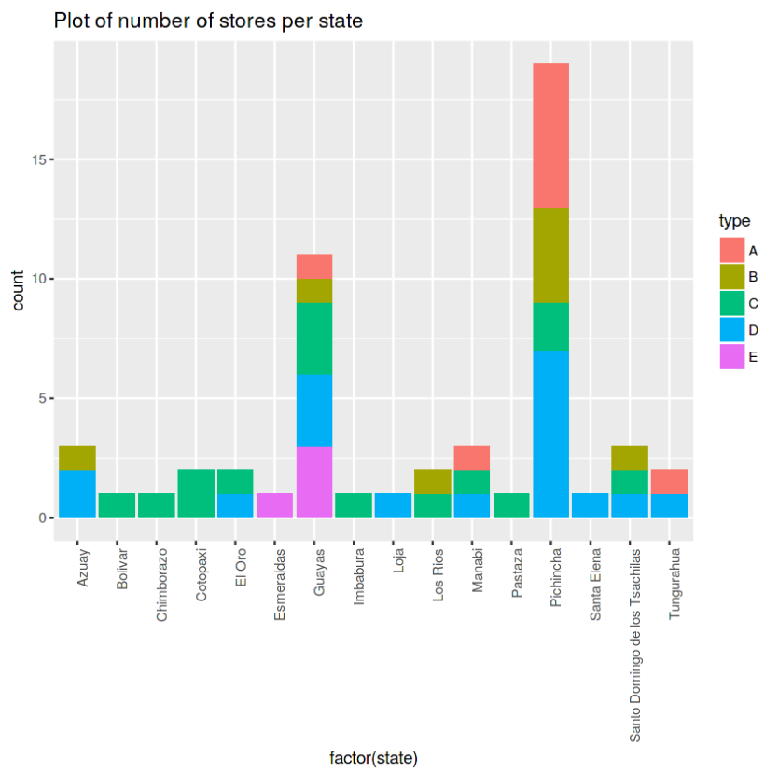
Stores per city & state

Slide 20
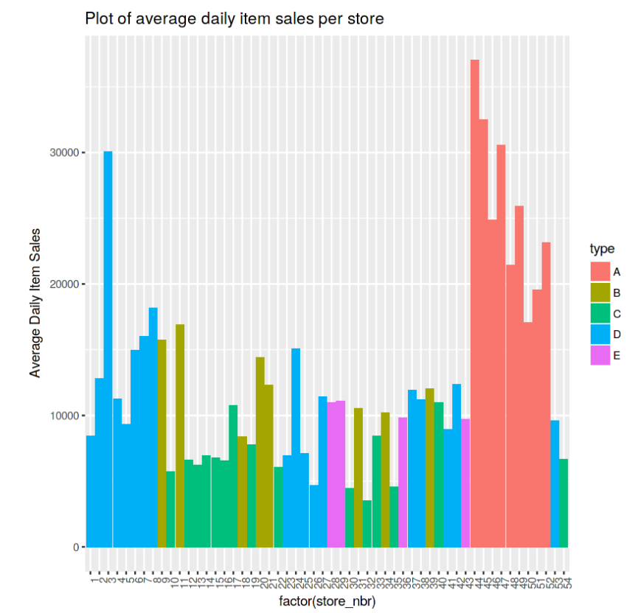
Avg daily item sales

Slide 21
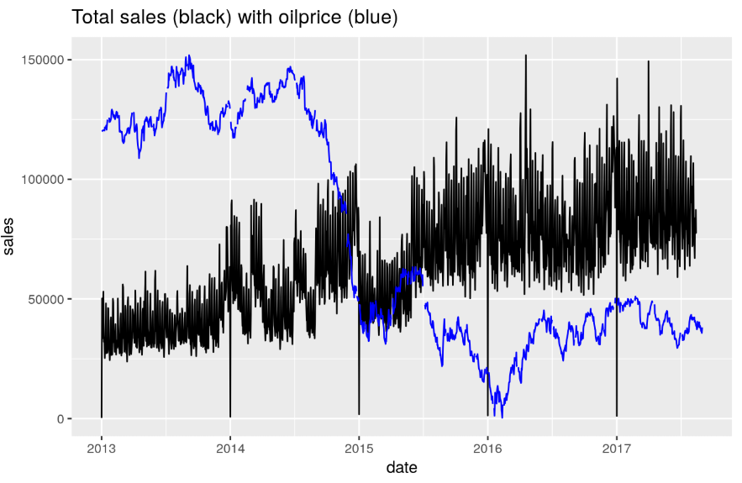
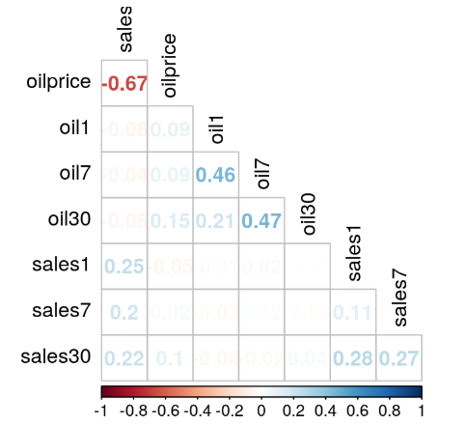
Oil price

Slide 22
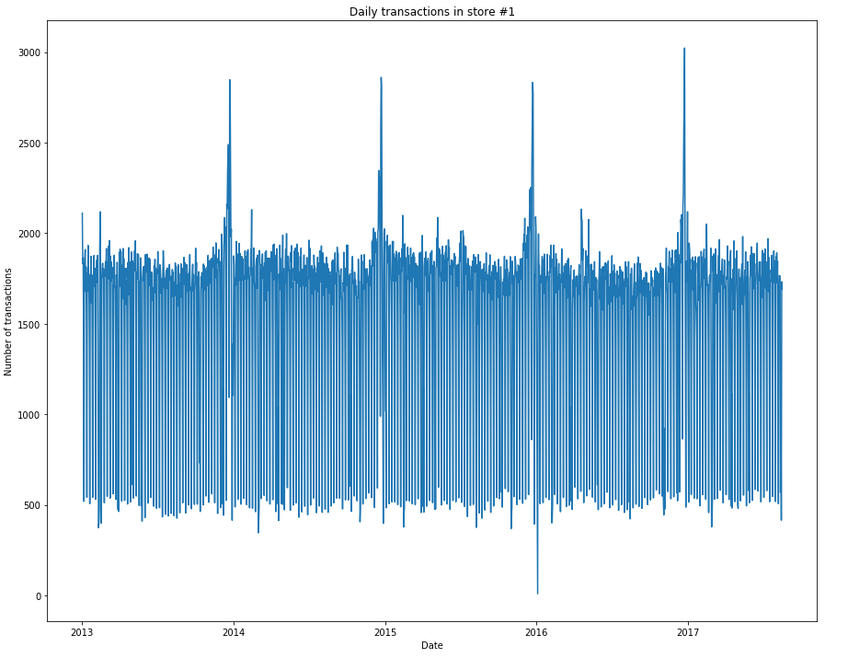
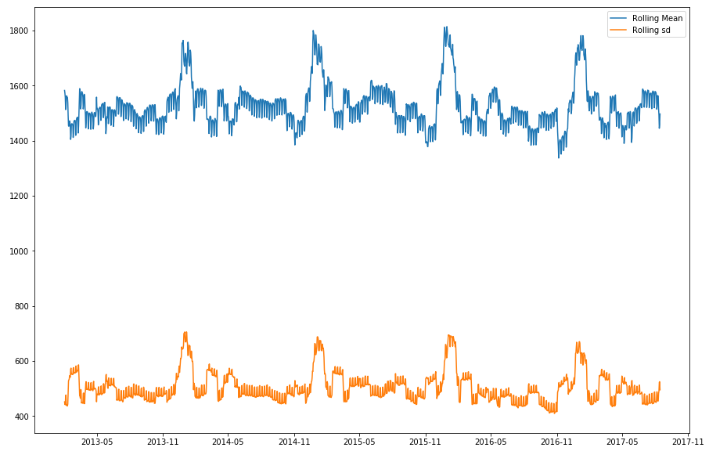
Single store in Quito

Slide 23
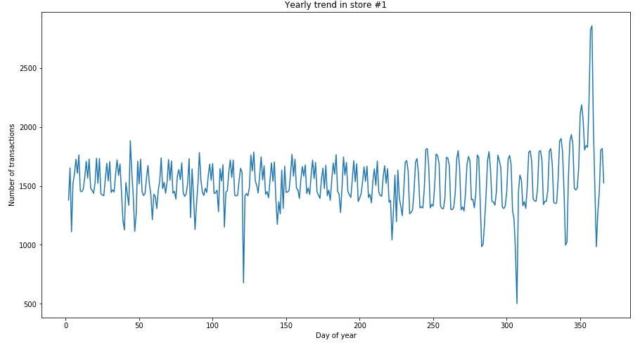
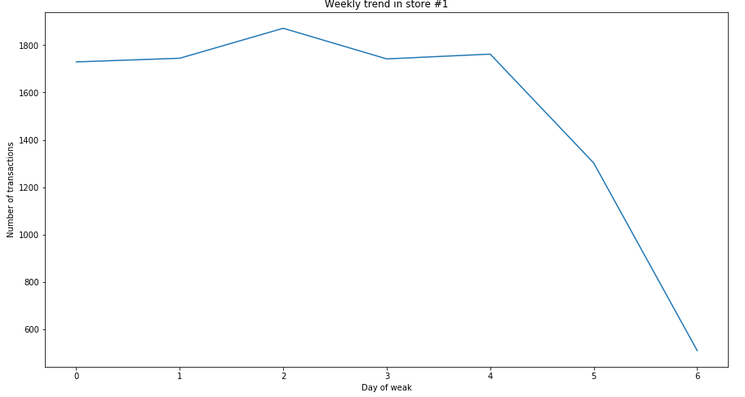
Single store in Quito

Slide 24
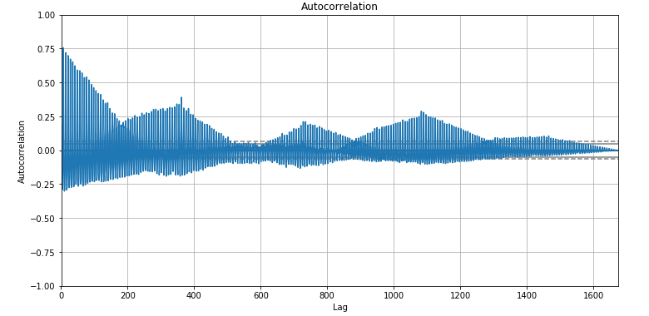
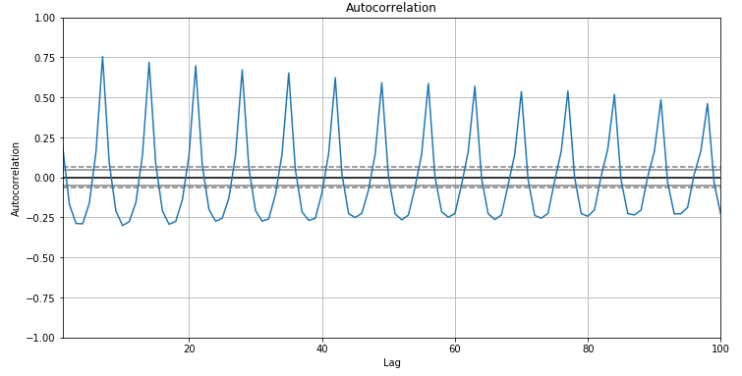
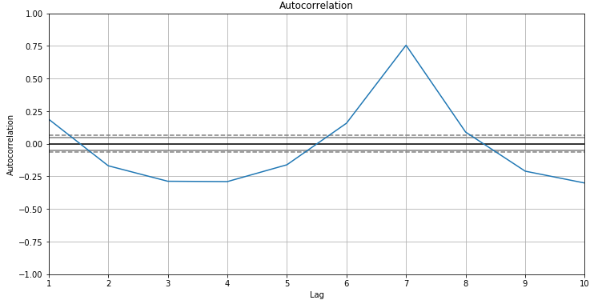
Single store in Quito
Autocorrelation

Slide 25
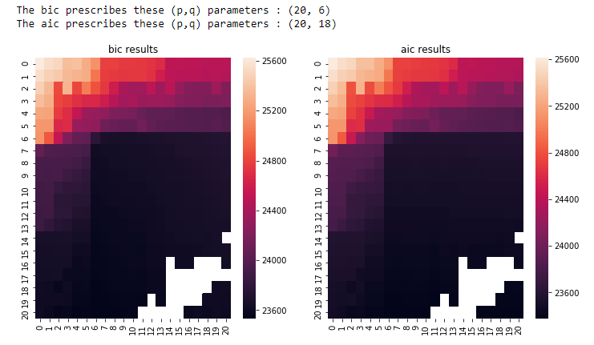
Single store in Quito
Coefficients

Slide 26
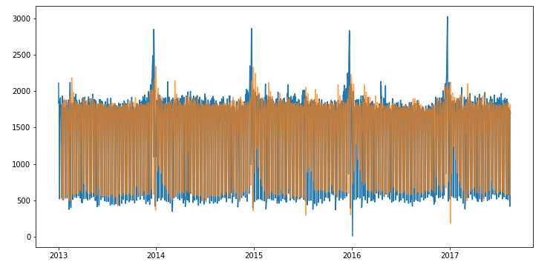
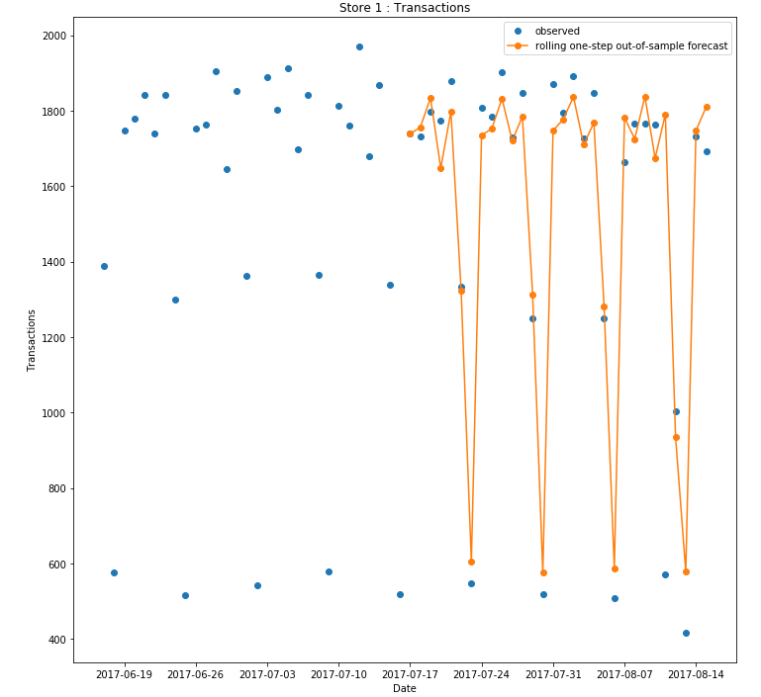
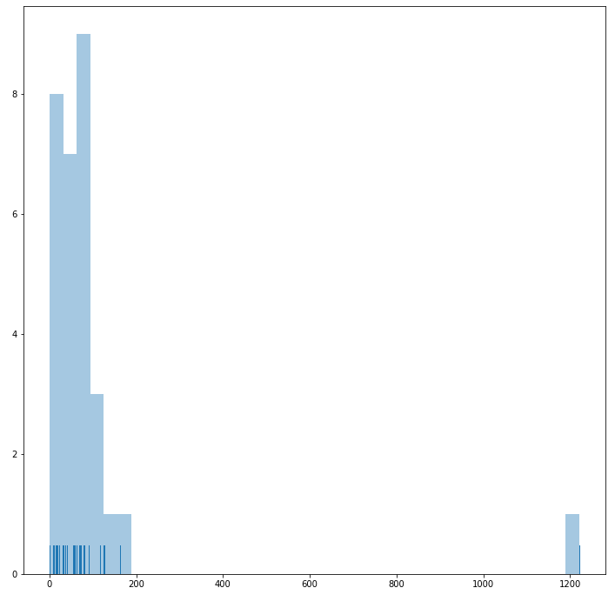
Single store in Quito
ARIMA fitting

Slide 27
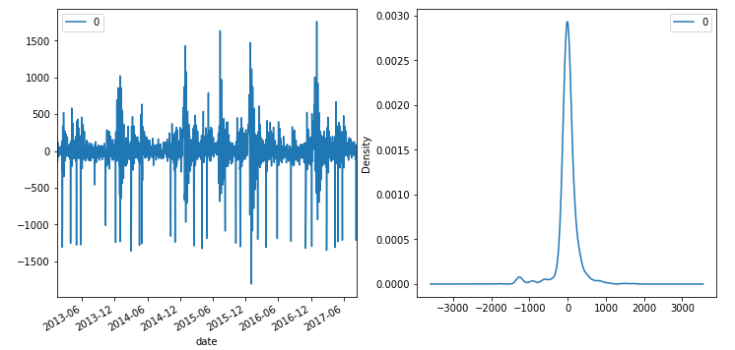
Single store in Quito
ARIMA residuals

Slide 28
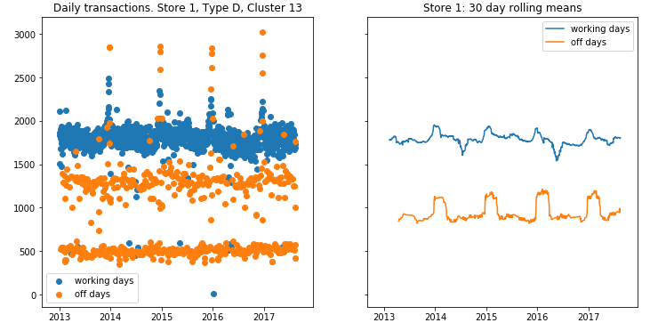
Transactions by day

Slide 29
Transactions by day

Slide 30
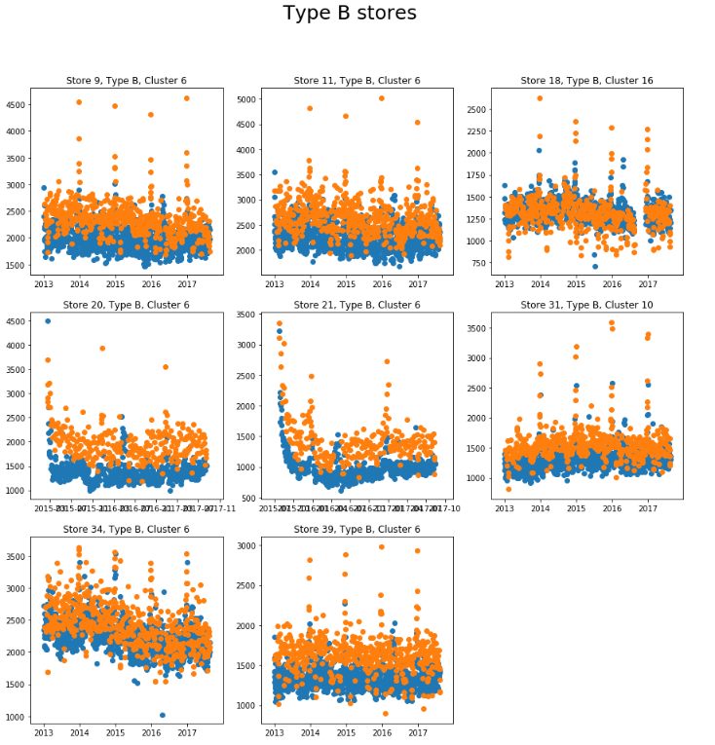
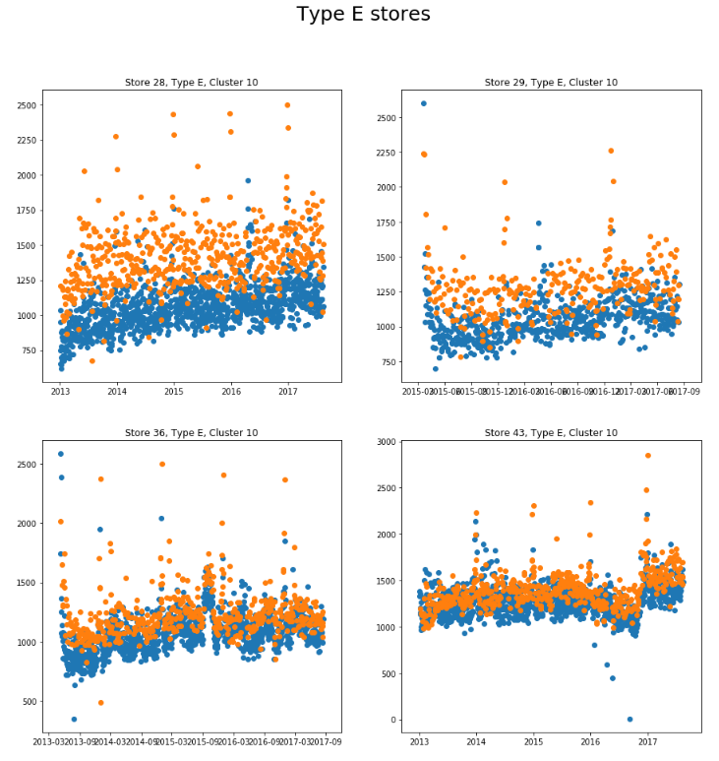
Transactions by type

Slide 31
Solutions (1 of 2)
Hardware limitation forced me to consider data starting from 01/01/2017.
Train data varies within 01/01/2017 to 26/07/2017. Validation data contains information from 26/07/2017 to 15/08/2017 and test data contains 16/08/2017 to 31/08/2017.
Its better to create temporal features since dates are given.
Creating temporal features for 3, 7, 14 days forward and 30, 60, 140 days backward.
Unit sales have been converted to 1 + natural logarithmic scales
Features include all the training features and mean, max, min, std values in different temporal scales as well as first, last and total sales days and promotion days as well as information about promotion on items spanning 16 days backward and 16 days forward as well as average promotion on items.
One hot encoding for categorical features.

Slide 32
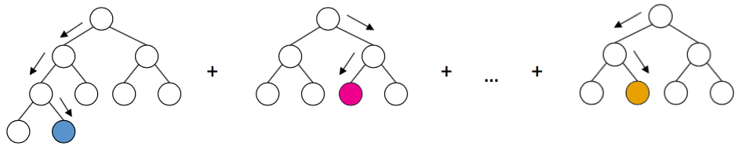

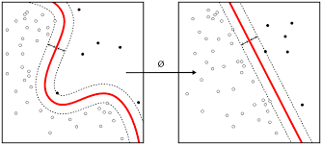
Model variety

Slide 33

Which one (s) ?
Depends on the data, the evaluation criteria.
Generalization capability.
Not overfitting neither underfiting.
The evaluation criteria is Normalized Weighted Root Mean Squared Logarithmic Error (NWRMSLE). where for row i, y_{i} is the predicted unit_sales of an item and y_{i} is the actual unit_sales; n is the total number of rows in the test set. The weights, w_{i}, can be found in the items.csv file. Perishable items are given a weight of 1.25 where all other items are given a weight of 1.00.

Slide 34
Model used (1 of 2)
LightGBM as starter
Memory efficient gradient boosting
Max num leaf in one tree = 80
Minimum num data in one leaf = 200 (to prevent overfitting)
Learning rate = 0.01
Bagging fraction = 0.7
Bagging frequency=1
Feature fraction = 0.8
Num boost rounds = 5000
Metric = l2 for regression
Earlystopping based on validation loss
NWRMSLE = 0.507

Slide 35
Model used (2 of 2)
LSTM in Keras
[LSTM (512), Batchnorm(), ReLU(), Dropout (0.2), Dense (256), Batchnorm(), PReLU(), Dropout (0.1), Dense (256), Batchnorm(), PReLU(), Dropout (0.1), Dense (128), Batchnorm(), PReLU(), Dropout (0.05), Dense (64), Batchnorm(), PReLU(), Dropout (0.05), Dense (32), Batchnorm(), PReLU(), Dropout (0.05), Dense (16), Batchnorm(), PReLU(), Dropout (0.05), Dense (1)
2000 epochs of training
Batchsize = 512
Earlystopping on validation loss and learning rate reduction on plateau.
Features are scaled with mean and std (except categorical features).
Initial learning rate = 0.001
2. NWRMSLE = 0.512

Slide 36
Alternative directions ?
Try reducing redundant features based on importance using random forests.
Optimize for hyperparameters using Gridsearch.
Try to incorporate useful features.
Extend analysis to use more data (currently due to hardware limitation less data is used).

Slide 37
What’s next ?
Think about scalability in terms of number of stores in local and global context.
Consider generalization i.e. can the model be used in a similar context yet in different problem scope.
More visualizations can be added based on inference and learning of gradient boosting to see at what stage which features are selected.
Make it production grade and user friendly.

Slide 38



